Slide 1



Slide 2
JADE Update and FENDL 3.2 beta testing

Slide 3
JADE Architecture
What’s new?
JADE “Umbrella” Paper
Preliminary FENDL 3.2 Beta V&V
Contents

Slide 4
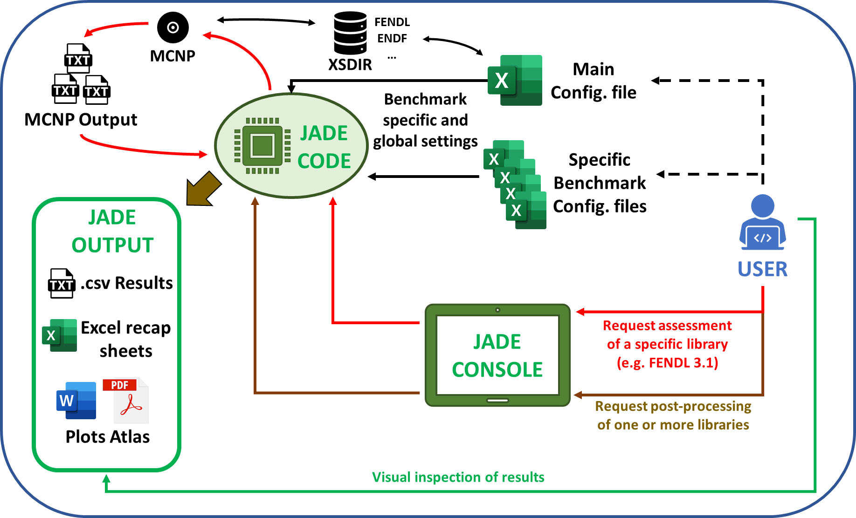
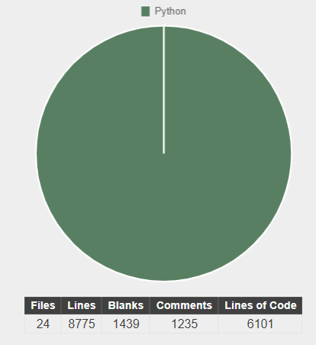
JADE Architecture
User have control both on a main configuration file and also on a specific configuration file for each implemented benchmark;
Assessment can be performed of each library that can be found in the user xsdir file;
The output includes both consistency checks on the single library and comparisons between different libraries or experiments.

Slide 5
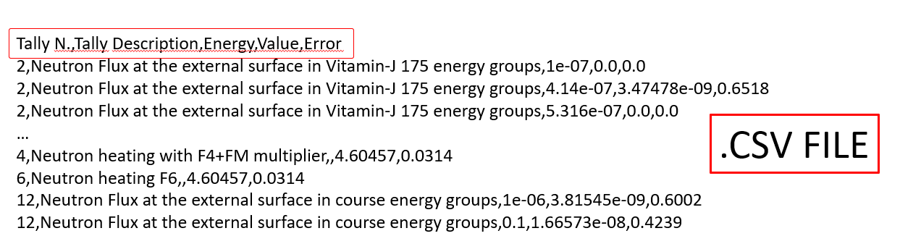

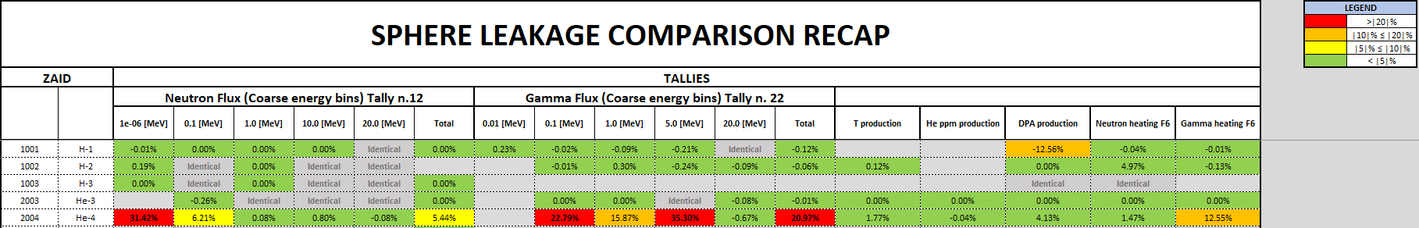
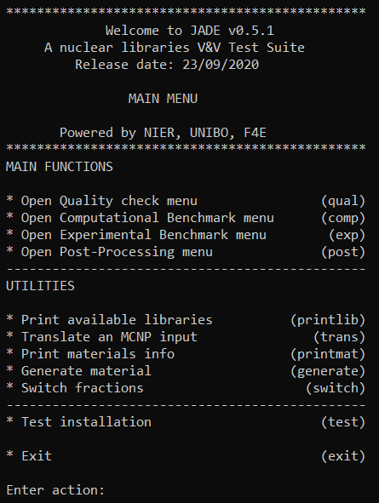

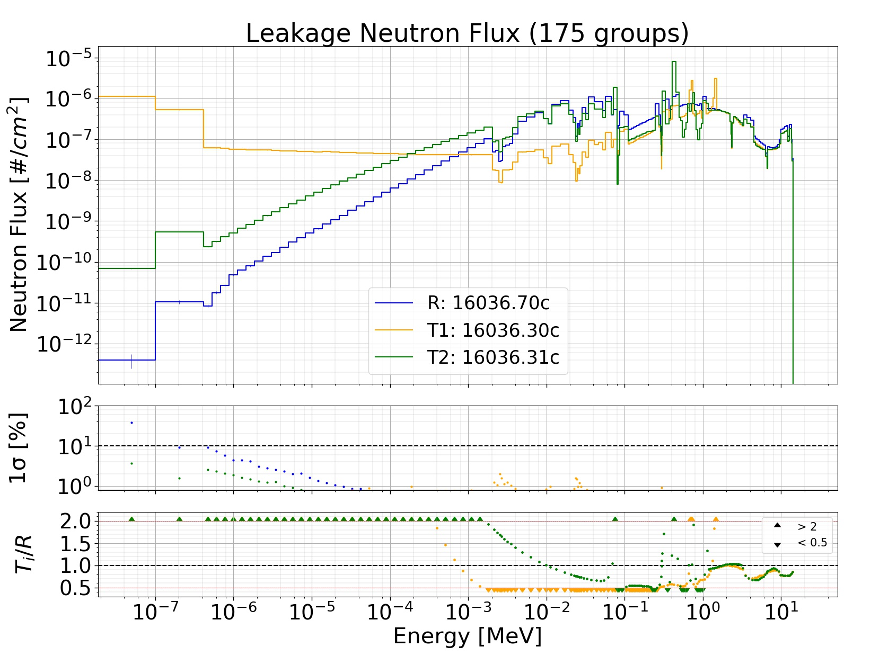
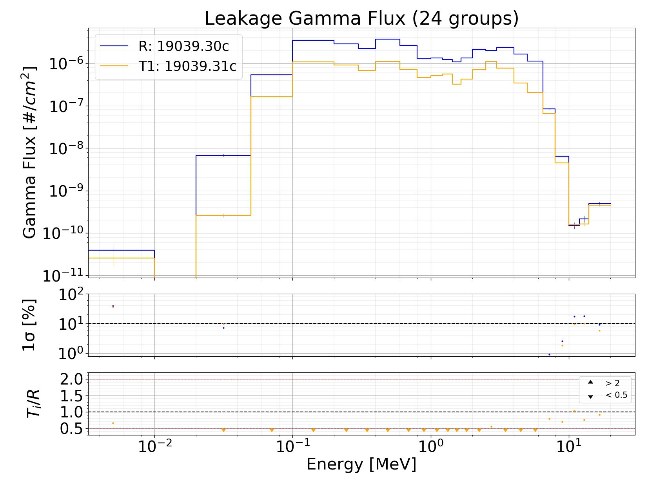


JADE Architecture

Slide 6
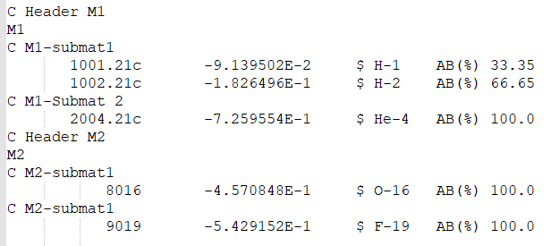
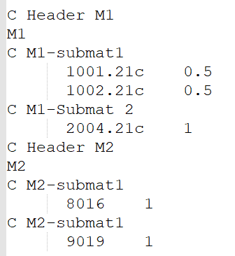
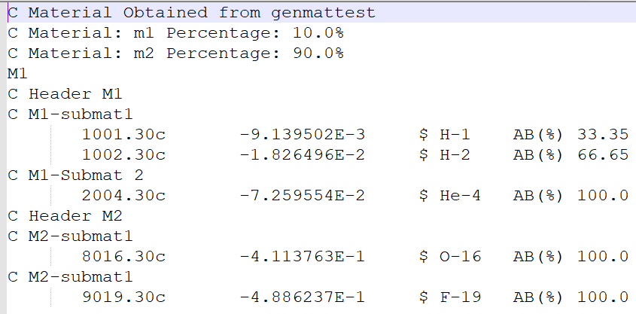
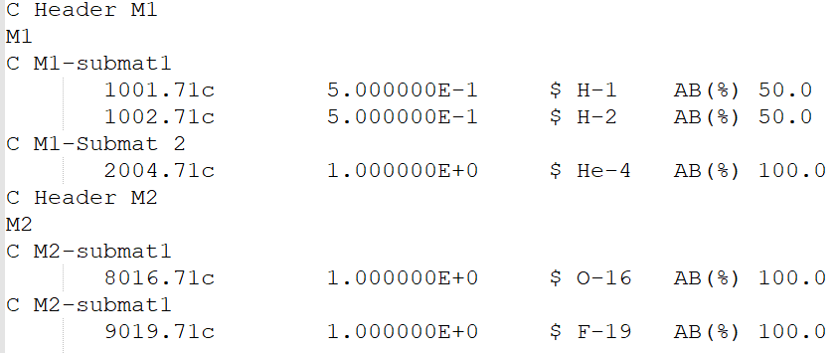
What’s new?
Utilities
MCNP Input
…
SWITCH
GENERATE
TRANS
…

Slide 7
What’s new?
Utilities
PRINTLIB
PRINTMAT

Slide 8
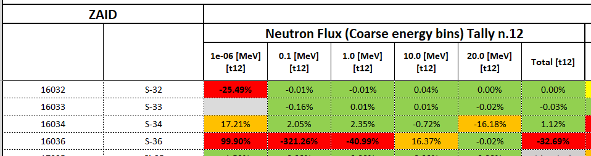
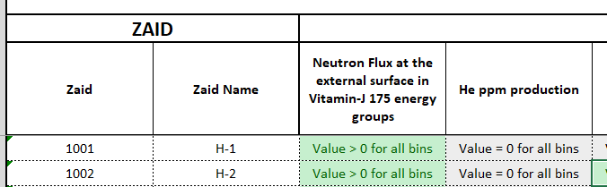
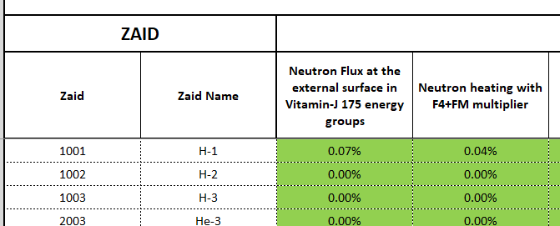
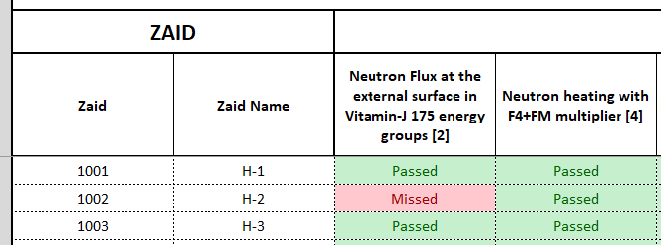
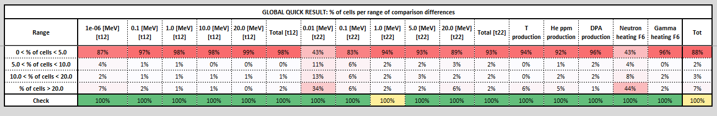
What’s new?
Comparison
Sheet
Consistency checks Sheet
Excel Output
Statistical Errors
Sheet
Introduced 10 MCNP Statistical Checks Sheet
Introduced a comparison summary

Slide 9
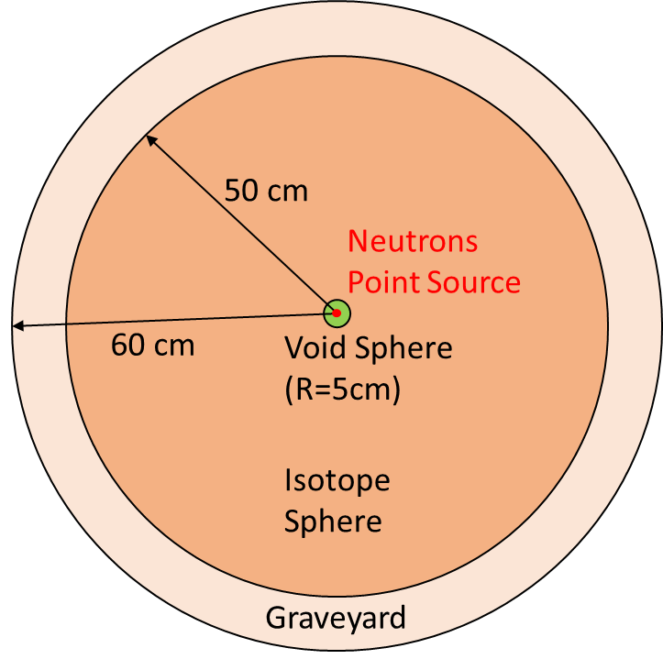
What’s new?
Benchmarks
COMPUTATIONAL
EXPERIMENTAL
The capability to add computational benchmarks without the need of further coding has been implemented.
Up to know the creation and run of the experimental benchmark is completed. Automatic post-processing implementation is on-going.
Sphere “leakage” computational benchmark is now finalized.
Oktavian Iron Sphere experiment is currently being implemented (SINBAD database).
ITER 1D Cylindrical calculation computational benchmark has been implemented.

Slide 10
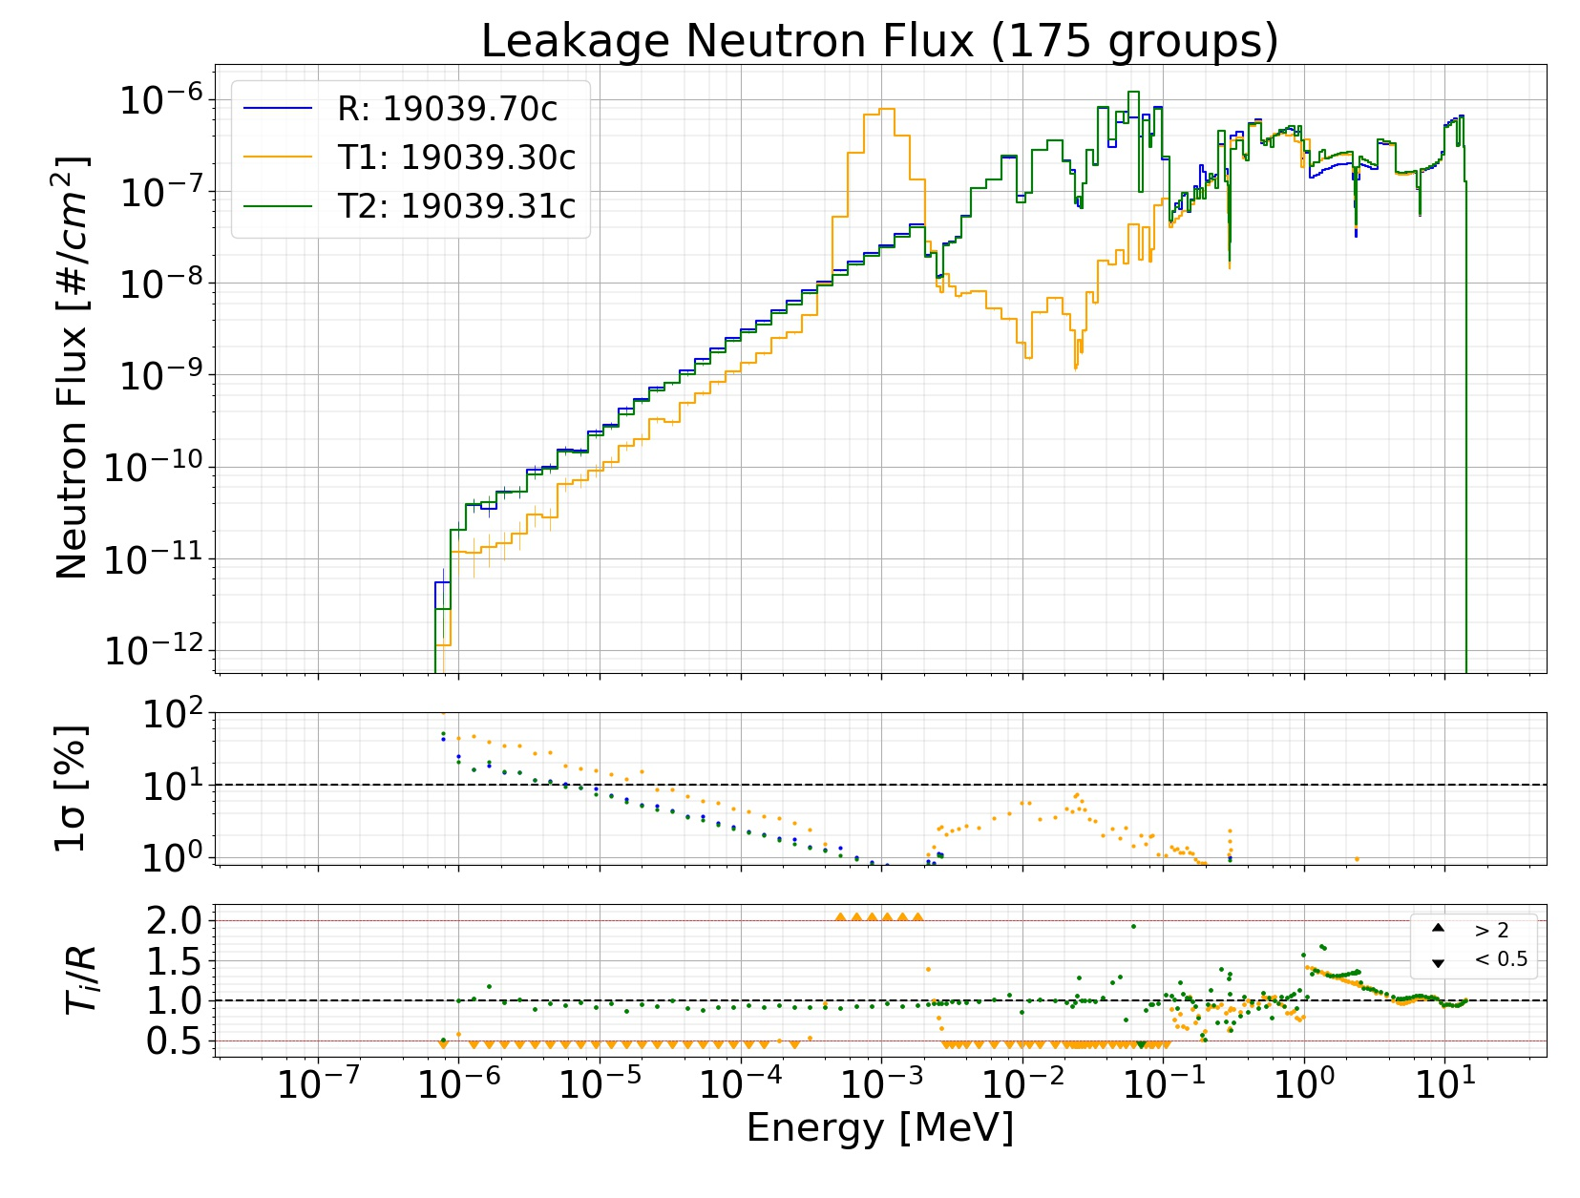
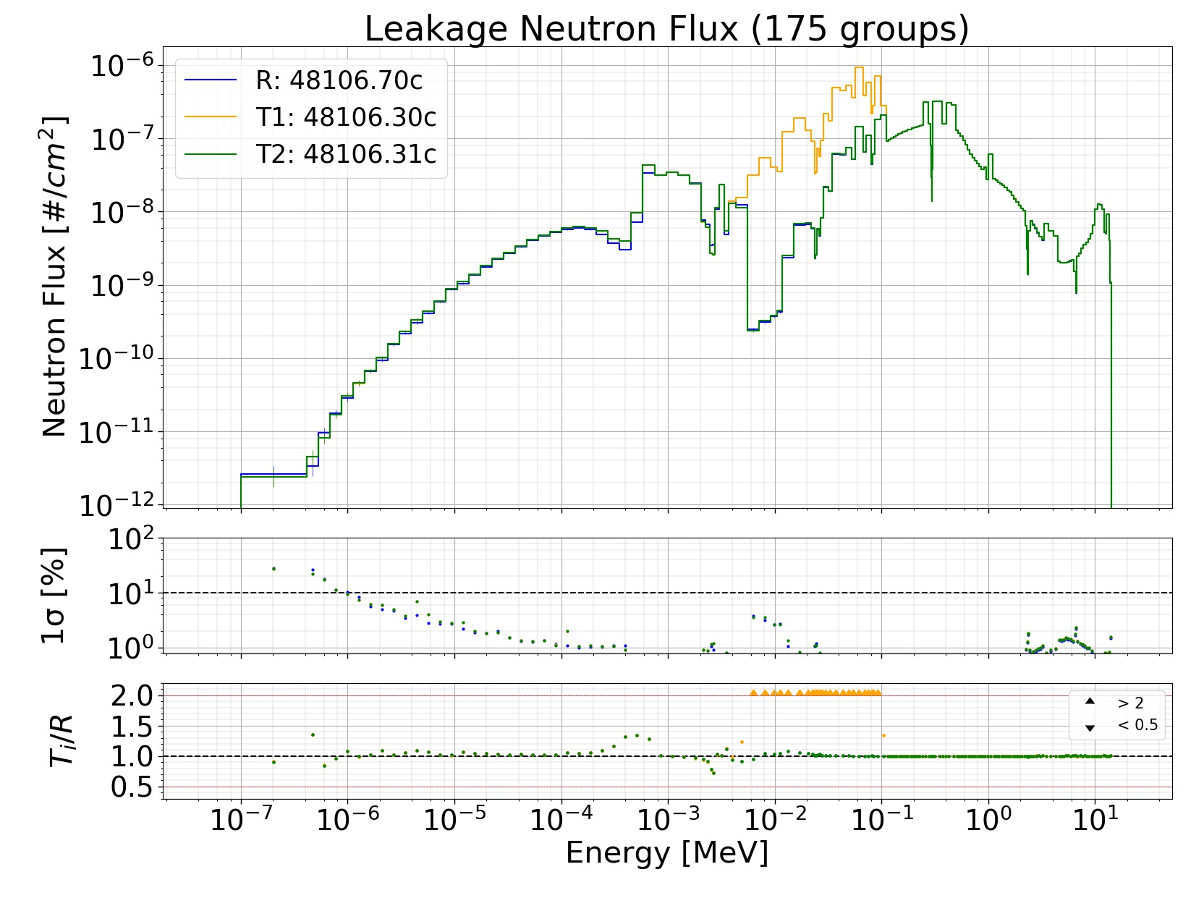
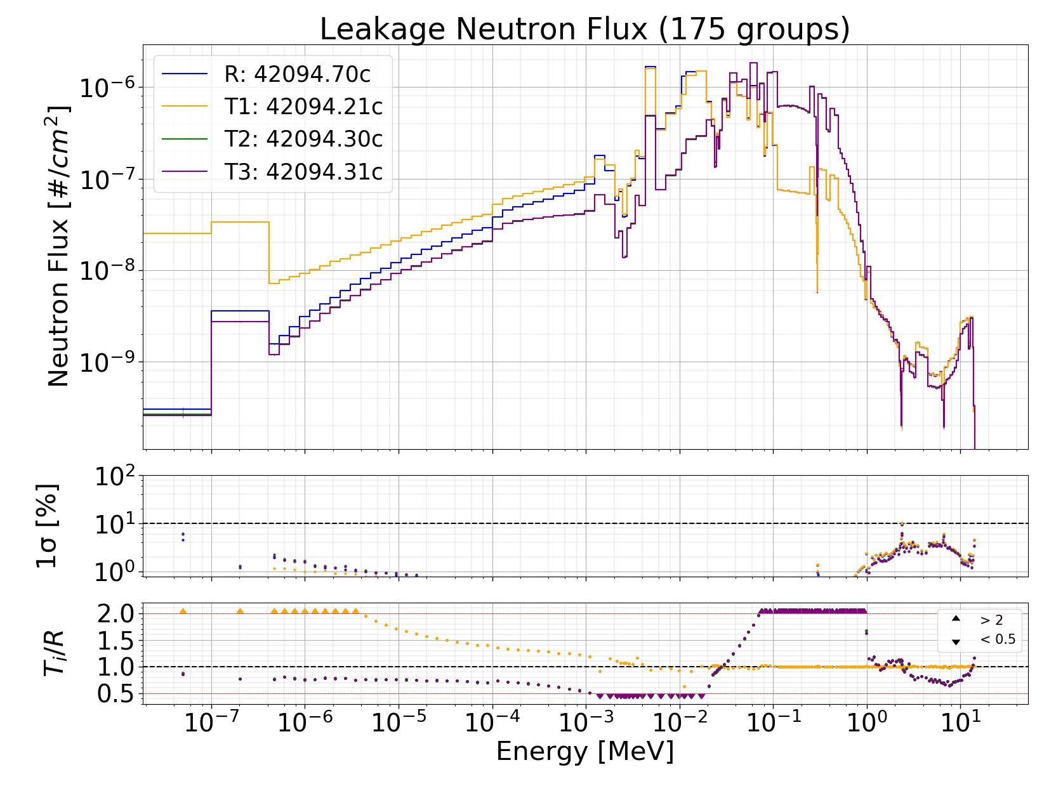
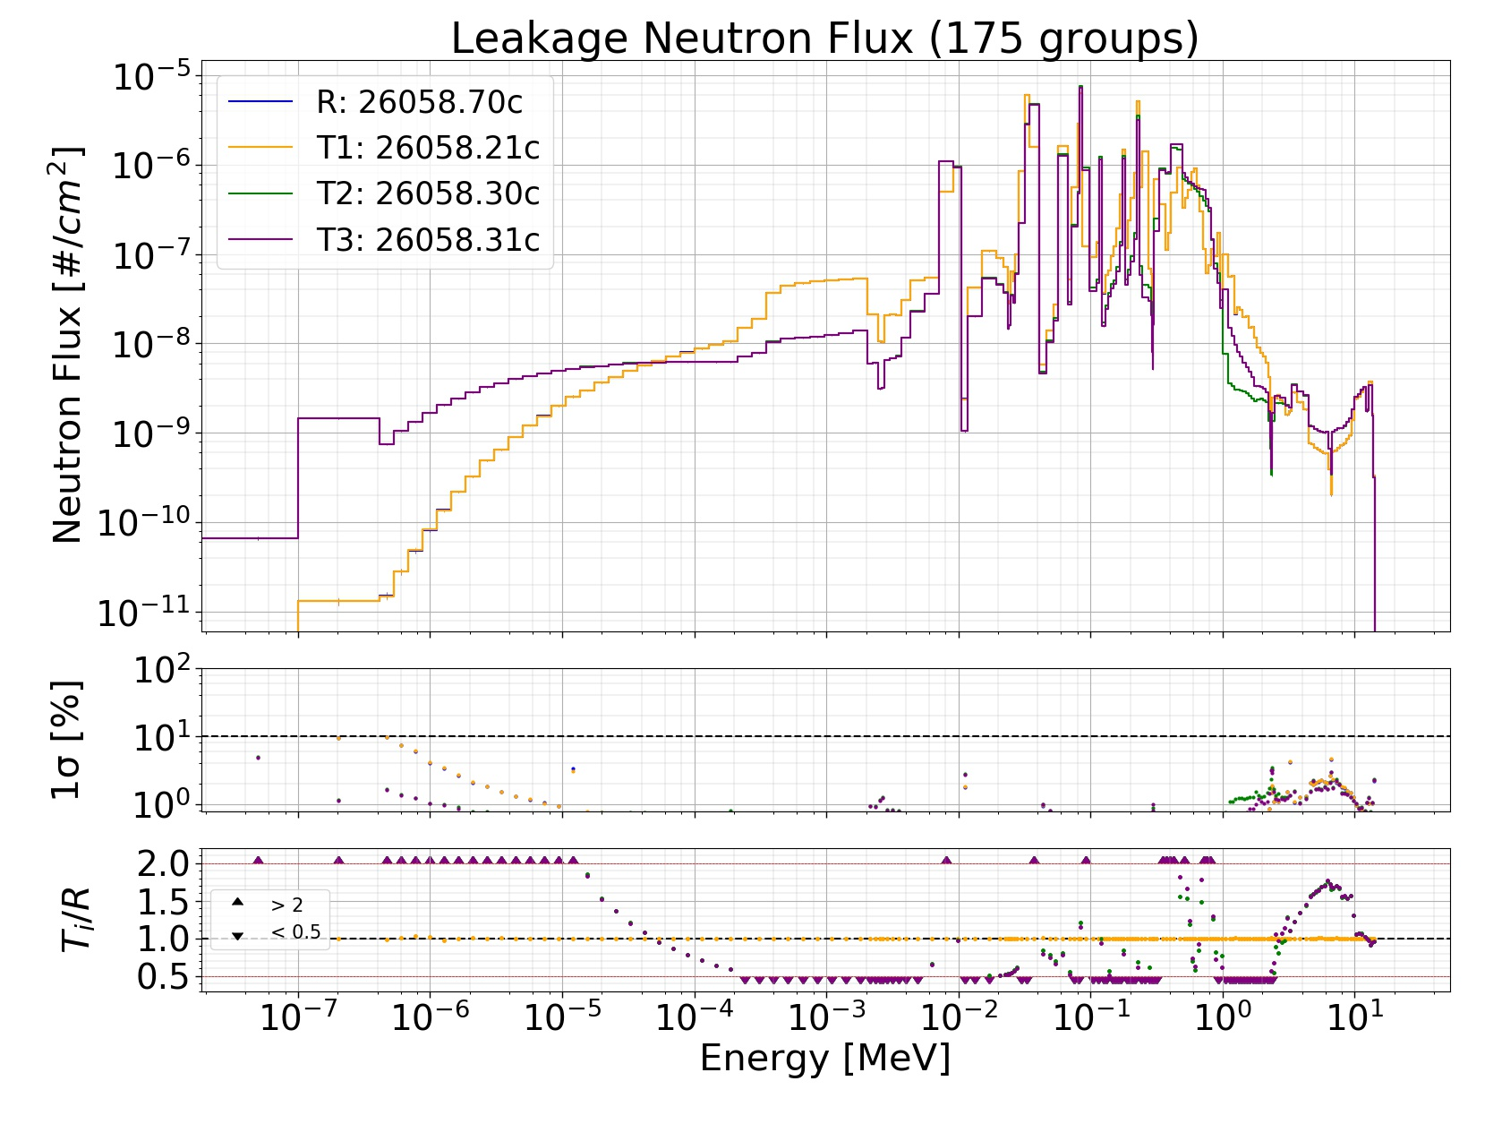
JADE “Umbrella” Paper
Free Access until 21st of December 2020: https://authors.elsevier.com/a/1b-o33HHIKKwqu
ATLAS plots
A comparison of performances on the Spere leakage benchmark was conducted between FENDL 2, FENDL 3.0, FENDL 3.1d and ENDF-VII.1. Results were published in Fusion Engineering and Design:
Davide Laghi, Marco Fabbri, Lorenzo Isolan, Raul Pampin, Marco Sumini, Alfredo Portone and Andrej Trkov, JADE, a new software tool for nuclear fusion data libraries Verification & Validation.
Significant differences were found in the resulting sphere leakage neutron flux obtained using the different libraries for S-36, Mo-94, K-39, Cd-106 and Fe-58.
S-36
K-39
Cd-106
Mo-94
Fe-58

Slide 11
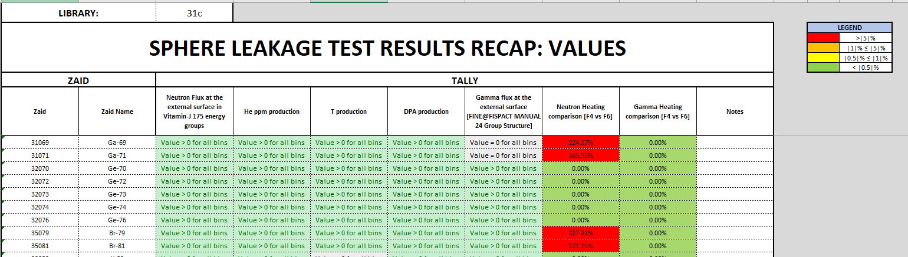
Free Access until 21st of December 2020: https://authors.elsevier.com/a/1b-o33HHIKKwqu
JADE “Umbrella” Paper
Consistency Checks
FENDL 3.1d: As expected, JADE was able to spot the previously discussed p-table problem thanks to the neutron heating computation comparison between the F4+FM and the F6 tallies. High differences have been observed for all isotopes of Gadolinium, Bromine, Molybdenum, Rhodium, Cadmium (except for Cd-106 and Cd-111), Antimony, Barium (except for Ba-138), Cesium-142 and Hafnium.

Slide 12
Preliminary FENDL 3.2 Beta V&V
General considerations
Only the Sphere Leakage benchmark has been used;
NO significant differences between FENDL 3.1.d and FENDL 3.2 has been registered except for the correction of the negative heating value that has been previously discussed;
Small differences for the Potassium neutron leakage flux have been observed.

Slide 13
Preliminary FENDL 3.2 Beta V&V
Sphere Leakage Excel Output
The Excel output file reports the punctual comparison of the results of FENDL 3.1.d Vs FENDL 3.2 for each isotope and each tally. The table below, summarize this comparison giving the percentage of cells (i.e. a specific isotope and tally) that show differences between 0% and 5%, 5% and 10%, 10% and 20% or more than 20%:
Main differences:
Neutron heating (F6) due to the p-table error in FENDL 3.1.d
Photon Leakage Flux below 0.01 MeV (Probably due to poor statistics in that energy bin)

Slide 14
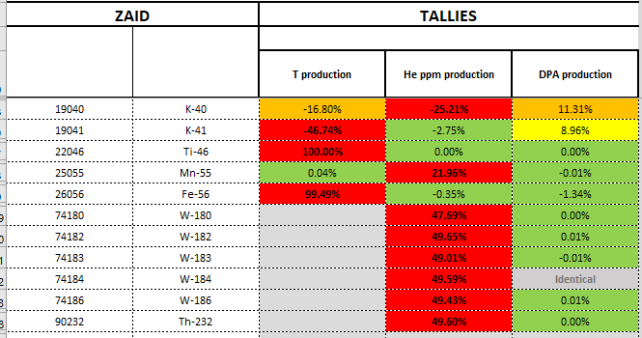
Preliminary FENDL 3.2 Beta V&V
Main differences in He, T and DPA production
Possible reasons for these differences are under investigation

Slide 15
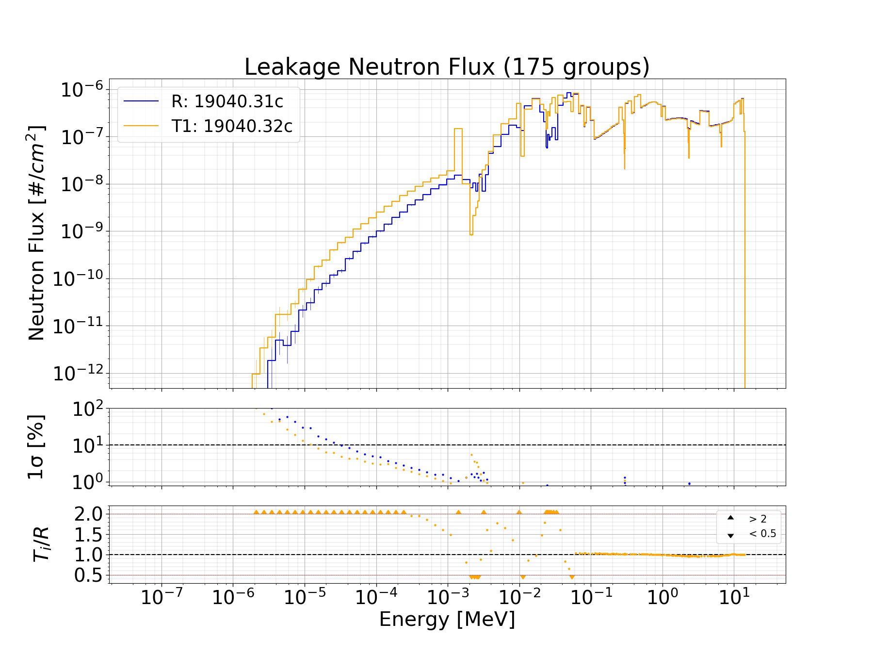
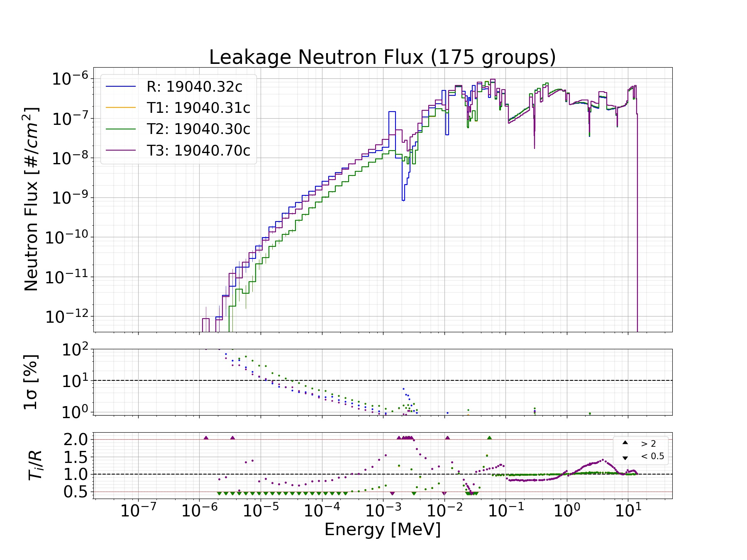
Preliminary FENDL 3.2 Beta V&V
Potassium
K-40, FENDL 3.1.d Vs FENDL 3.2
K-40, FENDL 3.2 Vs FENDL 3.1d, FENDL 3.0 vs ENDF-VII.1

Slide 16
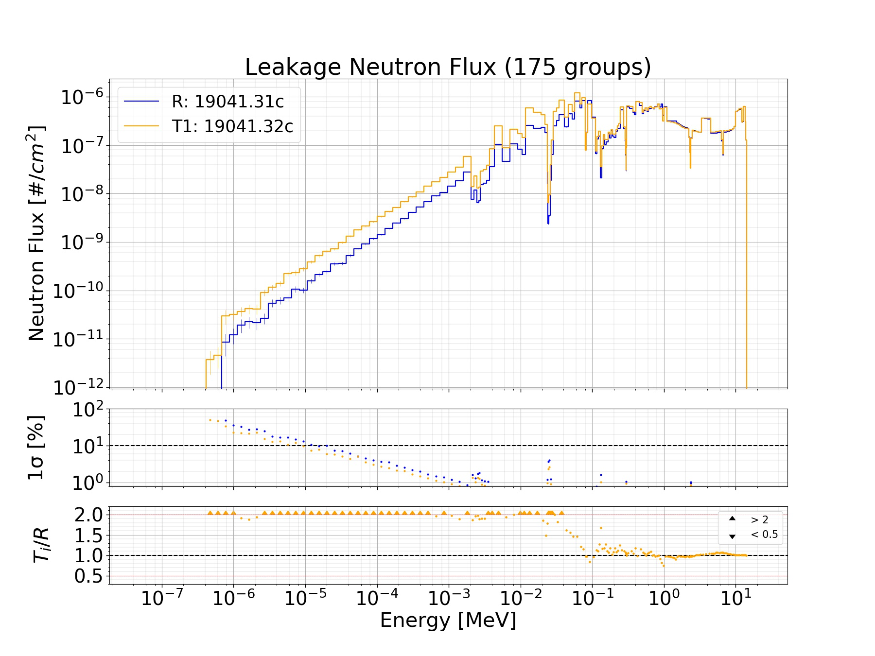
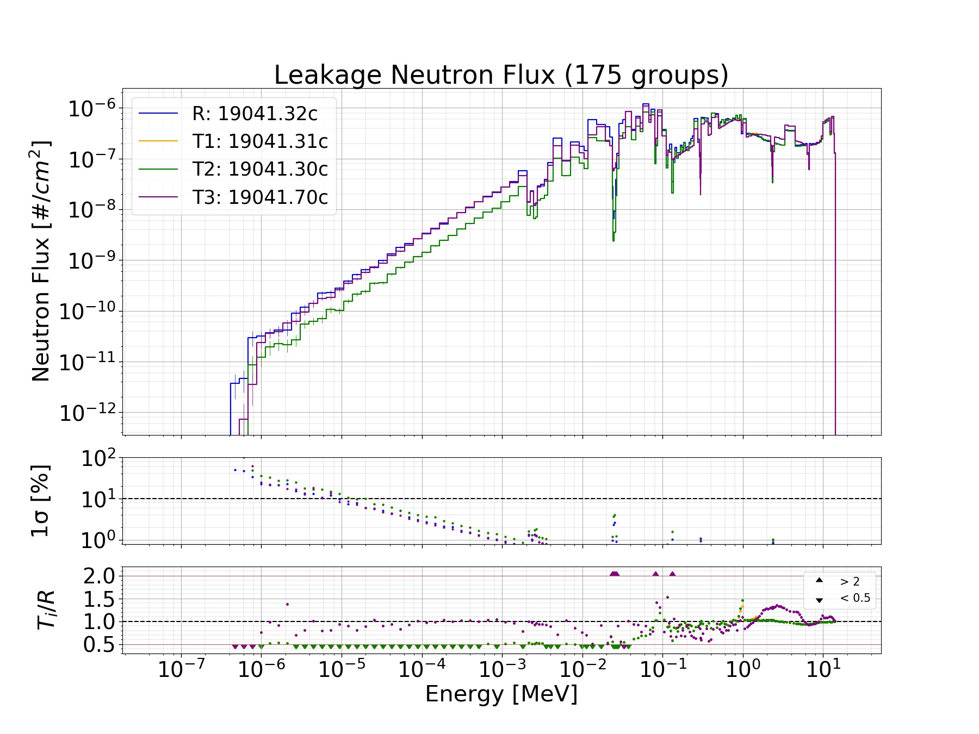
Preliminary FENDL 3.2 Beta V&V
Potassium
K-41, FENDL 3.1.d Vs FENDL 3.2
K-41, FENDL 3.2 Vs FENDL 3.1d, FENDL 3.0 vs ENDF-VII.1

Slide 17
Conclusion
JADE
New utilities have been added to JADE (or improved)
JADE general architecture is completed
Capability to populate the computational benchmark suite without further coding has been implemented
Implementation of first experimental benchmark is on-going
FENDL 3.2 Beta
A preliminary assessment of FENDL 3.2 beta has been conducted
No major issues have been spotted
Few discrepancies between FENDL 3.1.d and FENDL 3.2 are under investigation

Slide 18

Thanks for your kind attention!

